Slide 1
Constructions in Geometry
Units 2 and 4

Slide 2
Unit 2: Congruence, Similarity, and Proofs
Constructions of Lines and Angles

Slide 3
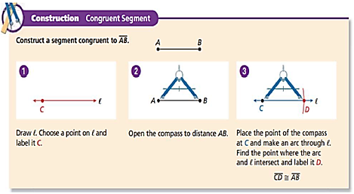
construction
Daily Agenda
What am I learning today?
What am I going to do today?
How will I show you that I’ve learned it?
G.CO.12 Make geometric constructions
Make formal geometric constructions with a variety of tools and methods
Daily Ticket out the Door
Copy a Segment, Construct a Segment Bisector
5 Question Daily Assessment
Copy an Angle, Construct an Angle Bisector
Construct Parallel Lines and Perpendicular Bisector
compass
straightedge
Construction: Congruent Segment

Slide 4
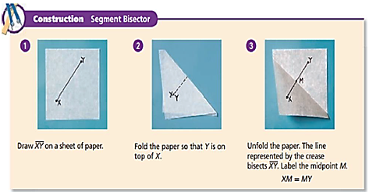
Daily Agenda
What am I learning today?
What am I going to do today?
How will I show you that I’ve learned it?
G.CO.12 Make geometric constructions
Make formal geometric constructions with a variety of tools and methods
Daily Ticket out the Door
Copy a Segment, Construct a Segment Bisector
5 Question Daily Assessment
Copy an Angle, Construct an Angle Bisector
Construct Parallel Lines and Perpendicular Bisector
segment bisector

Slide 5
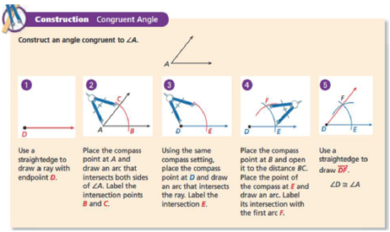
Congruent segments
Daily Agenda
Tick marks
What am I learning today?
What am I going to do today?
How will I show you that I’ve learned it?
G.CO.12 Make geometric constructions
Make formal geometric constructions with a variety of tools and methods
Daily Ticket out the Door
Copy a Segment, Construct a Segment Bisector
5 Question Daily Assessment
Copy an Angle, Construct an Angle Bisector
Construct Parallel Lines and Perpendicular Bisector
Congruent angles
Arc marks
Construction: Congruent Angle

Slide 6
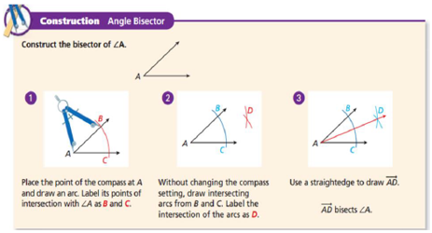
Daily Agenda
What am I learning today?
What am I going to do today?
How will I show you that I’ve learned it?
G.CO.12 Make geometric constructions
Make formal geometric constructions with a variety of tools and methods
Daily Ticket out the Door
Copy a Segment, Construct a Segment Bisector
5 Question Daily Assessment
Copy an Angle, Construct an Angle Bisector
Construct Parallel Lines and Perpendicular Bisector
Construction: Angle Bisector

Slide 7
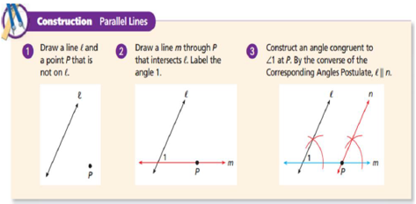
Daily Agenda
What am I learning today?
What am I going to do today?
How will I show you that I’ve learned it?
G.CO.12 Make geometric constructions
Make formal geometric constructions with a variety of tools and methods
Daily Ticket out the Door
Copy a Segment, Construct a Segment Bisector
5 Question Daily Assessment
Copy an Angle, Construct an Angle Bisector
Construct Parallel Lines and Perpendicular Bisector
Construction: Parallel Lines

Slide 8
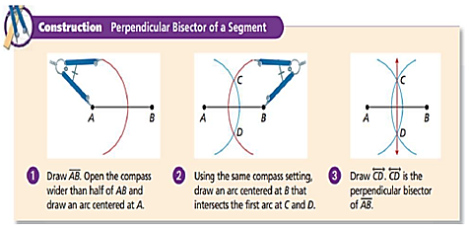
Daily Agenda
perpendicular bisector
What am I learning today?
What am I going to do today?
How will I show you that I’ve learned it?
G.CO.12 Make geometric constructions
Make formal geometric constructions with a variety of tools and methods
Daily Ticket out the Door
Copy a Segment, Construct a Segment Bisector
5 Question Daily Assessment
Copy an Angle, Construct an Angle Bisector
Construct Parallel Lines and Perpendicular Bisector
perpendicular
distance from a point on a line
Construction: Perpendicular Bisector

Slide 9
Unit 2: Congruence, Similarity, and Proofs
Constructions of Polygons

Slide 10
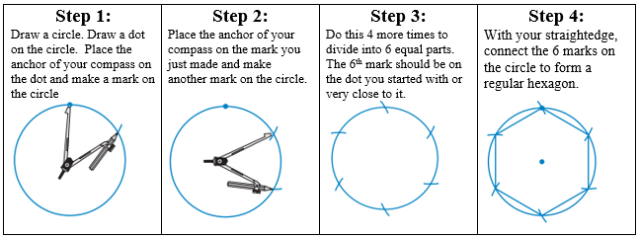
Daily Agenda
What am I learning today?
What am I going to do today?
How will I show you that I’ve learned it?
G.CO.13 Make geometric constructions
Construct an equilateral triangle, a square, and a regular hexagon, each inscribed in a circle
Daily Ticket out the Door
Construct a Square, Hexagon, and an Equilateral Triangle Inscribed in a Circle
5 Question Daily Assessment
hexagon
inscribed
vertex
Construction 1: Regular Hexagon

Slide 11
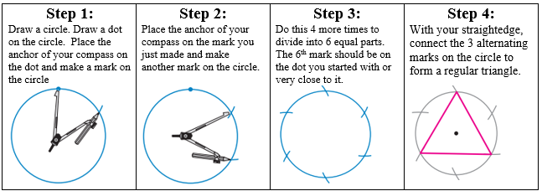
regular polygon
equiangular
Daily Agenda
What am I learning today?
What am I going to do today?
How will I show you that I’ve learned it?
G.CO.13 Make geometric constructions
Construct an equilateral triangle, a square, and a regular hexagon, each inscribed in a circle
Daily Ticket out the Door
Construct a Square, Hexagon, and an Equilateral Triangle Inscribed in a Circle
5 Question Daily Assessment
equilateral
angles
sides
equilateral
triangle
congruent

Slide 12
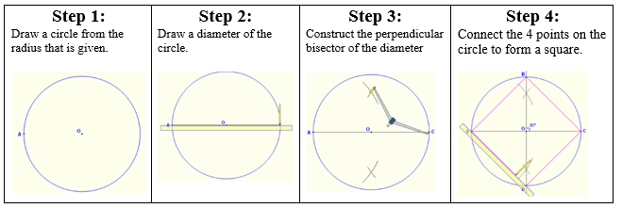
Daily Agenda
What am I learning today?
What am I going to do today?
How will I show you that I’ve learned it?
G.CO.13 Make geometric constructions
Construct an equilateral triangle, a square, and a regular hexagon, each inscribed in a circle
Daily Ticket out the Door
Construct a Square, Hexagon, and an Equilateral Triangle Inscribed in a Circle
5 Question Daily Assessment
Squares
90˚
Construction 3: Square

Slide 13
Unit 4:Circles
Constructions of Tangents, Circumscribed/Inscribed Circles with Triangles

Slide 14
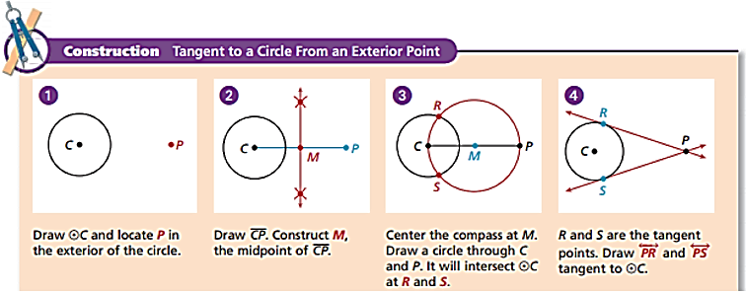
Daily Agenda
http://Construction: Tangent to a Circle

Slide 15
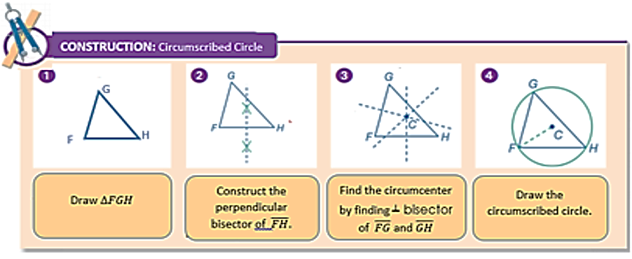
Daily Agenda
http://Construction: Circumscribed Circle

Slide 16
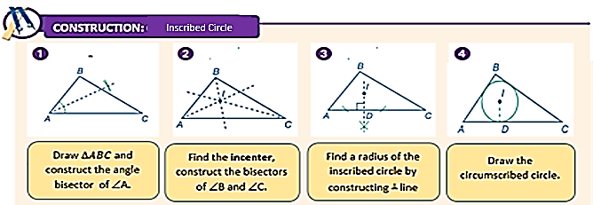
Daily Agenda
Construction: Inscribed Circle

Slide 17
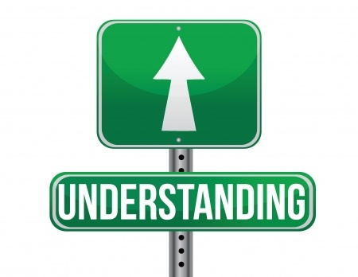
Checking for Understanding
Lesson 1: Constructions of Lines and Angles

Slide 18
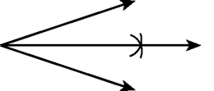
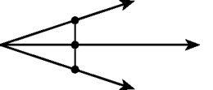
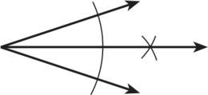
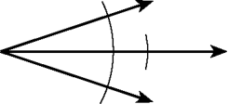
Checking for Understanding
1
Copyright© 2015 EducAide Software Inc. All rights reserved.
Notes:
D

Slide 19
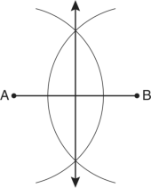
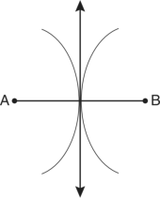
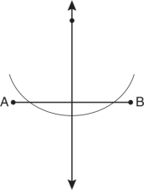
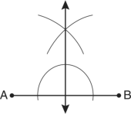
Checking for Understanding
2
Which diagram shows the construction of the perpendicular bisector of $\overline{AB}?$
Copyright© 2015 EducAide Software Inc. All rights reserved.
Notes:
A

Slide 20
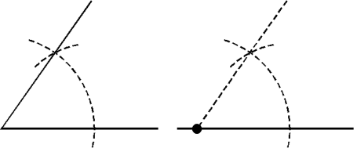
Checking for Understanding
3
Copyright© 2015 EducAide Software Inc. All rights reserved.
Notes:
C

Slide 21
Checking for Understanding
4
Copyright© 2015 EducAide Software Inc. All rights reserved.
Notes:
A

Slide 22
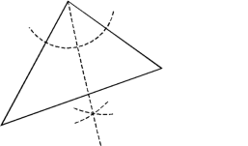
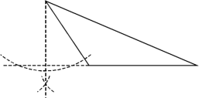
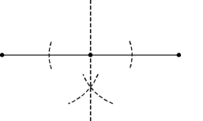
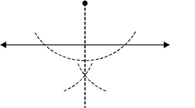
Checking for Understanding
5
Copyright© 2015 EducAide Software Inc. All rights reserved.
Notes:
D

Slide 23
Checking for Understanding
6
Which of the following is NOT a tool used in constructions?
Compass
Pen
Straightedge
Ruler
Copyright© 2015 EducAide Software Inc. All rights reserved.
Notes:
B

Slide 24
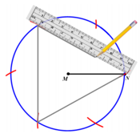
Checking for Understanding
7
Which of the following constructions represent the picture below.
Constructing a Square Inscribed in a Circle
Constructing a Triangle Inscribed in a Circle
Constructing a Circle Inscribed in a Triangle
Constructing a Hexagon Inscribed in a Circle
Copyright© 2015 EducAide Software Inc. All rights reserved.
Notes:
B

Slide 25
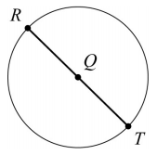
Checking for Understanding
8
Consider the beginning of a construction of a square inscribed in circle Q.
Step 1: Label point R on circle Q
Step 2: Draw a diameter through R and Q
Step 3: Label the intersection on the Circle point T
What is the next step in this construction?
Draw radius $\overline{SQ.}$
Label point S on circle Q.
Construct a line segment parallel to $\overline{RT}$
Construct the perpendicular bisector of $\overline{RT}$
Copyright© 2015 EducAide Software Inc. All rights reserved.
Notes:
B or D

Slide 26
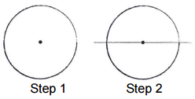
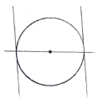
Checking for Understanding
8
Use the diagram to answer the question.
Daja is drawing a square inscribed in a circle using a compass and a straightedge two steps are shown.
Which is the best step for Daja to do next?
Copyright© 2015 EducAide Software Inc. All rights reserved.
Notes:
D

Slide 27
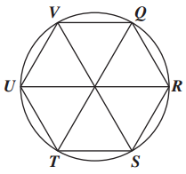
Checking for Understanding
9
In the design, a hexagon is inscribed in a circle.
Which point shows the location of Point Q after a 240˚ clockwise rotation around the center?
S
T
U
V
Copyright© 2015 EducAide Software Inc. All rights reserved.
Notes:
C

