Slide 1

DAY 1 – Parallel Lines & Transversals

Slide 2
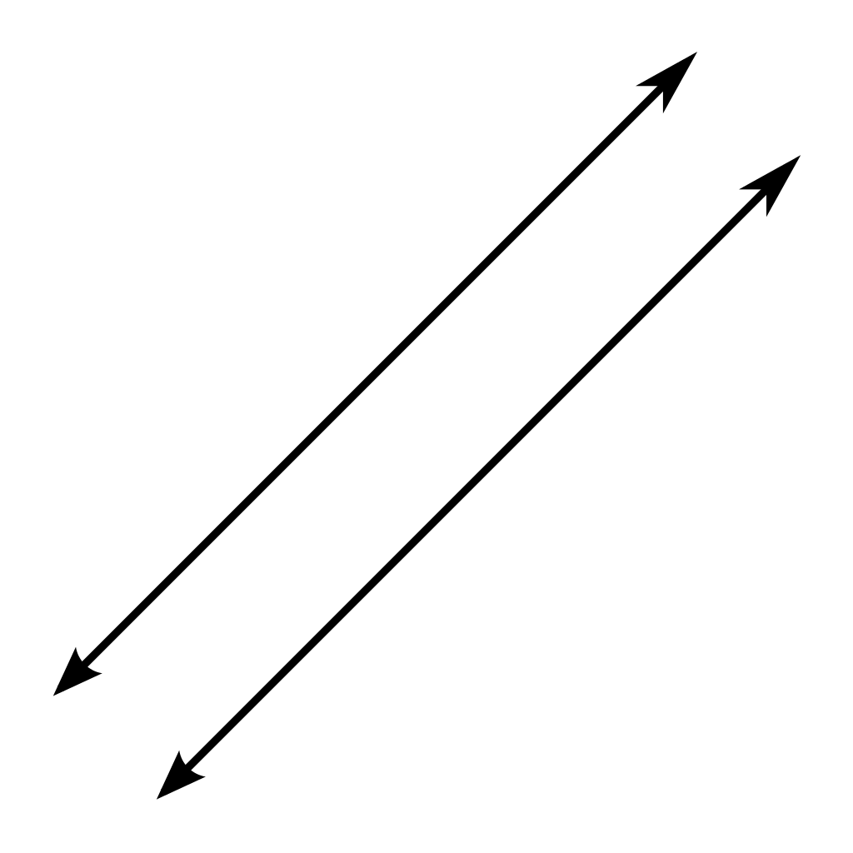
Parallel Lines
Never intersect
Have a constant distance between them
Have the same slope

Slide 3
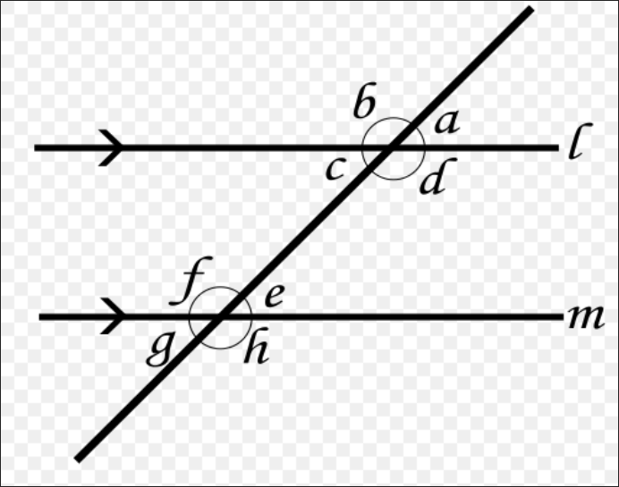
Transversal
A transversal cuts two or more parallel lines at two distinct points.
Allows for special pairs of angles to form.
An angle breaks up a plane into three regions.

Slide 4
Regions created by an angle
EXTERIOR of the angle
INTERIOR of the angle
ON the angle

Slide 5
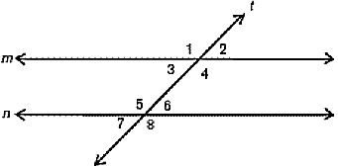
Alternate Exterior
Alternate: Opposite
Exterior: Outside
Theorem: Pairs of alternate exterior angles are congruent.
Angles 1 & 8

Slide 6
Alternate Interior
Alternate: Opposite
Interior: Inside
Theorem: Pairs of alternate interior angles are congruent.
Angles 4 & 5

Slide 7
Consecutive
Exterior
Consecutive: Next to; One after the other
Exterior: Outside
Theorem: Pairs of consecutive exterior angles are supplementary.
Angles 1 & 7

Slide 8
Consecutive
Interior
Consecutive: Next to; One after the other
Interior: Inside
Theorem: Pairs of consecutive exterior angles are supplementary.
Angles 3 & 5

Slide 9
Corresponding
Corresponding: Equivalent; the same
Theorem: Pairs of corresponding angles are congruent.
Angles 3 & 7

Slide 10
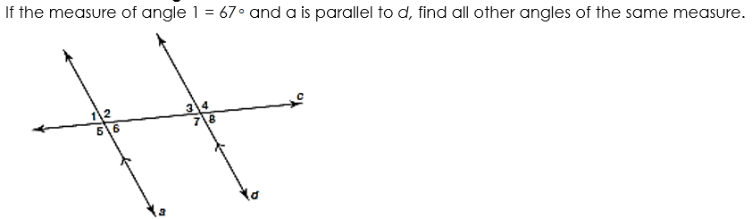
CHECK FOR UNDERSTANDING
Angle 6 – Vertical Angle
Angle 3 – Corresponding Angle
Angle 8 – Alternate Exterior Angle

Slide 11
WHITE BOARD WORK
Solve for X.
Be ready to explain your work.
Have reason for your answer

Slide 12
WHITE BOARD WORK
Find the measurement of angle ABD.
Does your answer make sense?

Slide 13
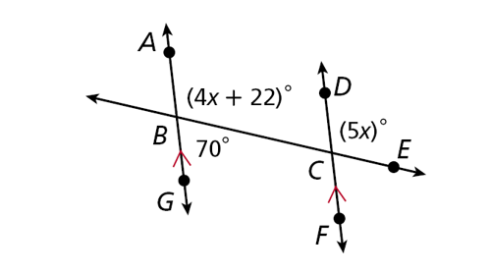
CHECK FOR UNDERSTANDING
Solve for x in more than one way.

Slide 14

Work-Session

Slide 15
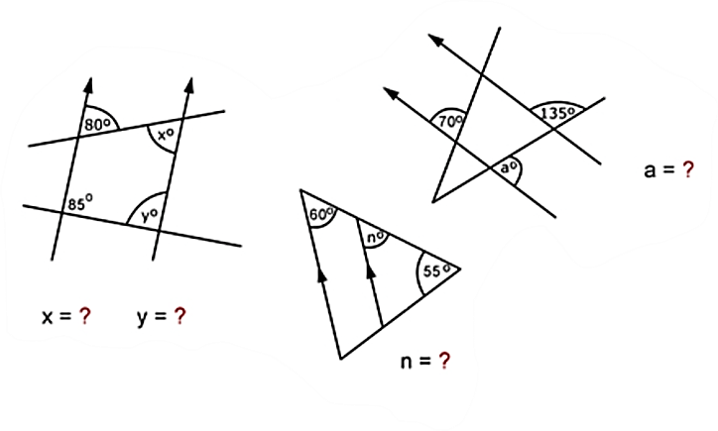
T.O.T.D.
X = __________
Y = __________
N = __________
A = __________

Slide 16
DAY 2 – Congruent Triangles

Slide 17
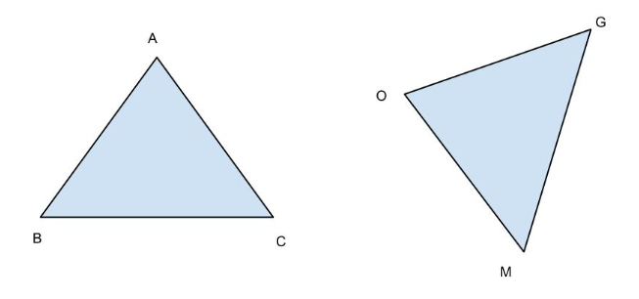
Congruence in Triangles
Two triangles are congruent if and only if their corresponding angles and sides are congruent.
Corresponding parts: matching parts/sides/angles
Corresponding Parts of Congruent Triangles are Congruent (CPCTC)
Later we will use CPCTC as part of our proofs.

Slide 18
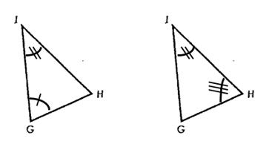
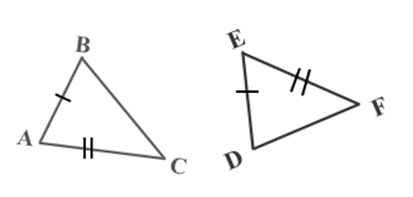
Included Parts
Included Side
  The side between two angles
  Segment IG
Included Angle
  The angle between two sides
  Angle A

Slide 19
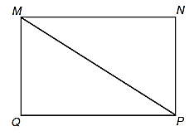
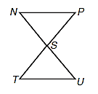
Extra Markings
Share a side
  Reflexive Property
  Segment MP
Vertical Angles
  Vertical Angles are Congruent
  Angles NSP & UST

Slide 20
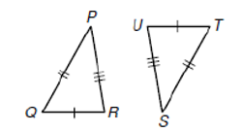
Side-Side-Side
Three sides of 1 triangle are congruent to three sides of another triangle, the triangles are congruent.
WhiteBoards: Congruent Sides

Slide 21
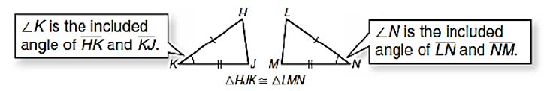
Side-Angle-Side
If two sides and the included angle of one triangle are congruent to two sides and the included angle of another, the triangles are congruent.

Slide 22
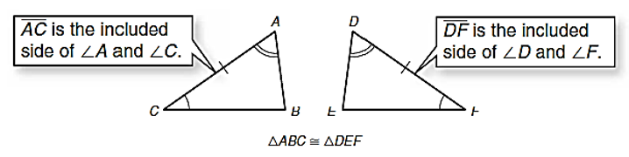
Angle-Side-Angle
If two angles and the included side are congruent to two angles and the included side of another triangle, then the two triangles are congruent.

Slide 23
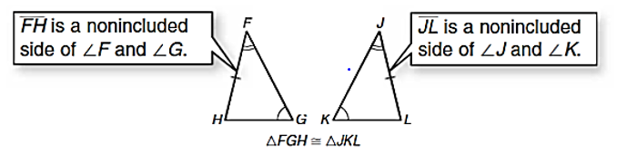
Angle-Angle-Side
If two angles and a nonincluded side of one triangle are congruent to the corresponding two angles and nonincluded side, then the two triangles are congruent.

Slide 24
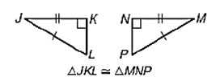
Hypotenuse-Leg
If the hypotenuse and a leg of a right triangle are congruent to the hypotenuse and a leg of another right triangle, then the triangles are congruent.

Slide 25
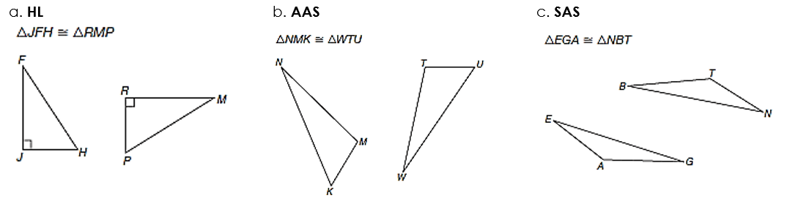
CHECK FOR UNDERSTANDING
Mark the appropriate sides and angles to make each congruence statement true by the stated congruence theorem.

Slide 26
DAY 3 – Similarity and Proportions

Slide 27

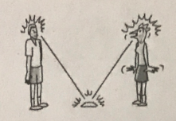
Magic Mirror
Legend has it that if you stare into a person’s eyes in a special way, you can hypnotize them into squawking like a chicken.
Your victim has to stand exactly 200 cm away from a mirror and stare into it.
The only tricky part is that you need to figure out where you have to stand so that when you stare into the mirror, you are also staring into your victim’s eyes.
If your calculations are correct and you stand at the correct distance, you will be able to stare directly into the victim’s eyes.

Slide 28

THINK: Take 3 minutes to think about why this worked?
PAIR: Take 3 minutes to pair with your partner. Compare your thoughts and revise if necessary.
Magic Mirrors:
Why were we able to see in each others’ eyes no matter what the heights were?
SHARE: Be prepared to share you & your partners thoughts with the class.

Slide 29
RATIOS & PROPORTIONS
Comparison of two quantities.
The Cross-Product
In any true proportion, the cross-products are equal.
Proportion
The ratio of a to b can be expressed as $\frac{a}{b}$, where b ≠ 0.
The ratio of a to b can be expressed as 𝑎/𝑏, where b ≠ 0.
An equation stating two ratios are equal
$\frac{a}{b}=\frac{c}{d}$; therefore $ad=bc$
𝑎/𝑏=𝑐/𝑑; therefore 𝑎𝑑=𝑏𝑐

Slide 30

SIMILARITY
Figures that are similar have the same shape, but not necessarily the same size.
In order to prove figures are similar, their corresponding angles must be congruent and their corresponding sides must be proportional.
If two figures are congruent, they are always similar.
If two figures are similar, they are not congruent.

Slide 31
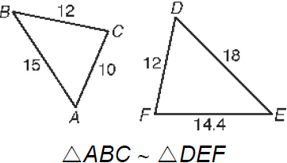

Side-Side-Side
Similarity Statement
If the measures of the corresponding sides of two triangles are proportional, the figures are similar.
Proportion of Sides:
$$\frac{15}{18}=\frac{10}{12}=\frac{12}{14.4}$$

Slide 32
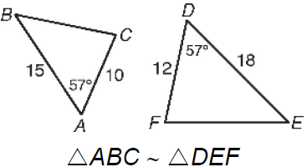

Side-Angle-Side Similarity Statement
If the measures of two sides of a triangle are proportional to the measures of two corresponding side of another triangle and the included angles are congruent, the figures are similar.
Proportion of Sides:
$$\frac{12}{10}=\frac{18}{15}$$

Slide 33
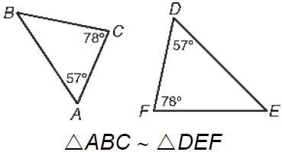
Angle-Angle
Similarity Statement
If two angles of one triangle are congruent to two angles of another triangle, the triangles are similar.
Explanation:
The sides of the triangle can extend, making one triangle larger than the other (Proportional).

Slide 34
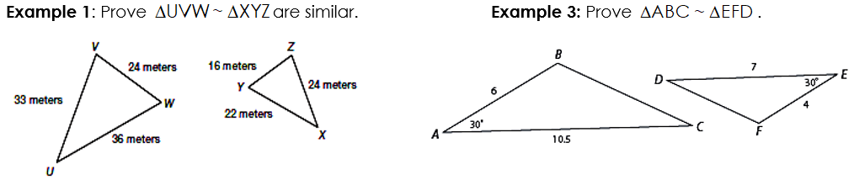
CHECK FOR UNDERSTANDING

Slide 35
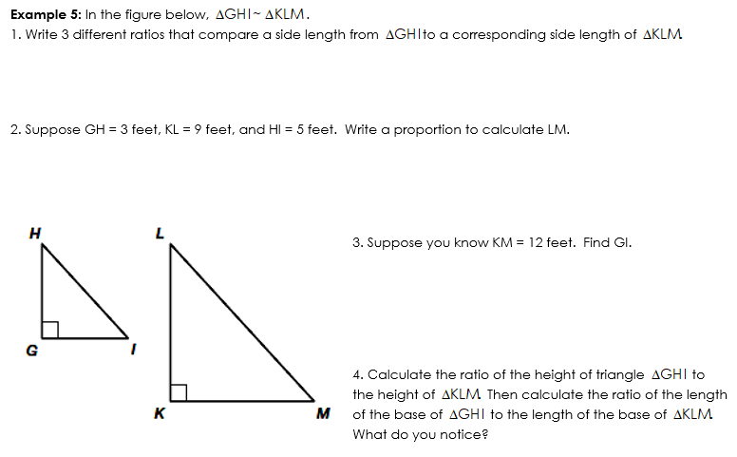

Slide 36
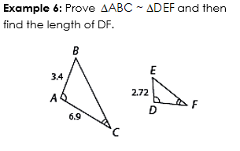
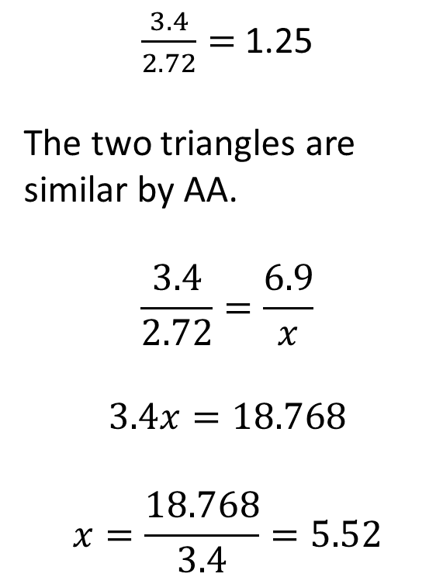
$\frac{3.4}{2.72}=$ 1.25
The two triangles are similar by AA.
$$\frac{3.4}{2.72}=\frac{6.9}{x}$$
$$3.4x=18.768$$
$$x=\frac{18.768}{3.4}=5.52$$

Slide 37
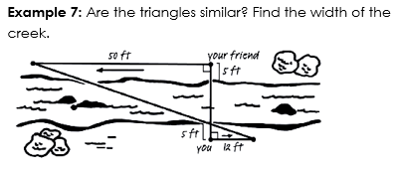
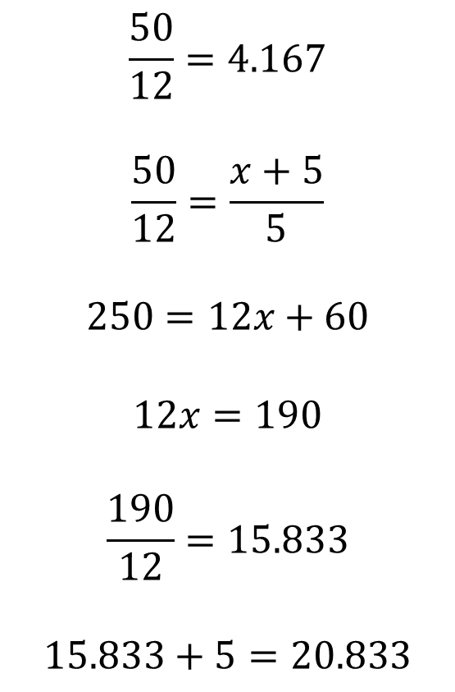
$$\frac{50}{12}=4.167$$
$$\frac{50}{12}=\frac{x+5}{5}$$
$$250=12x+60$$
$$12x=190$$
$$\frac{190}{12}=15.833$$
$$15.833+5=20.833$$

Slide 38

Review for Quiz 2.1-2.2
Parallel Lines & Transversal
Congruent Triangles
Corresponding Parts

Slide 39
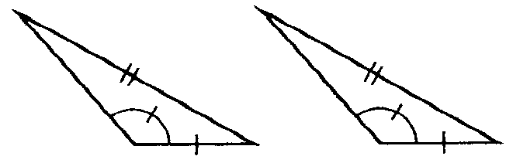
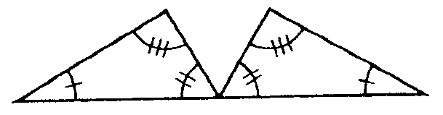
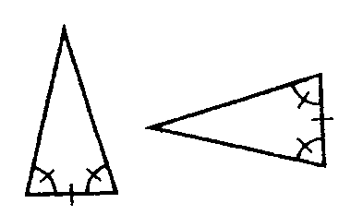
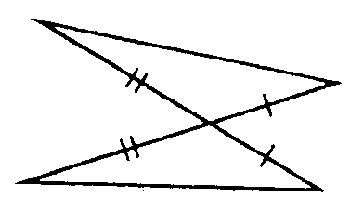
Congruent Triangles
Are these triangles congruent?
If so, how?
Which two ways can you NOT prove triangles to be congruent?

Slide 40
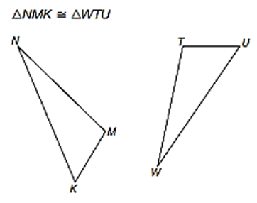

Side-Angle-Side
These two triangles are congruent by SAS.
List all the corresponding parts of the triangles.
$\overline{NM}≅\overline{WT}$
$Angle M ≅Angle T$
$\overline{MK}≅\overline{TU}$

Slide 41


Side-Angle-Side
Which segment is congruent to $\overline{EA}$?
$\overline{EA}≅\overline{NT}$

Slide 42
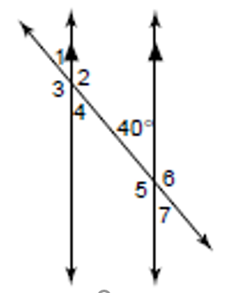
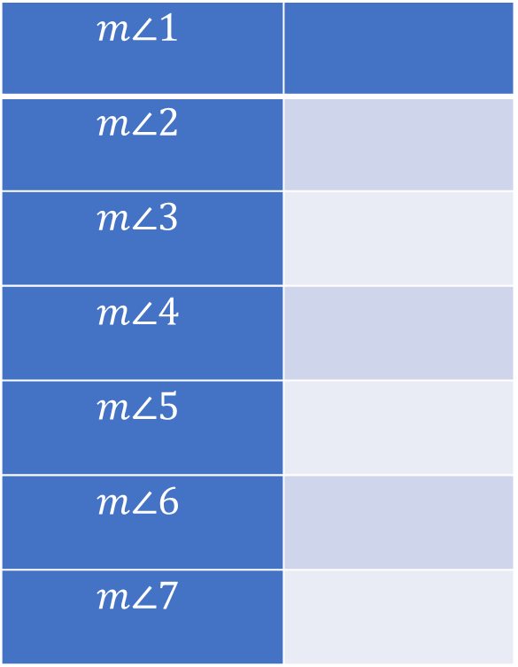
Find the measures of the angles.
$$m∠1$$
$$m∠2$$
$$m∠3$$
$$m∠4$$
$$m∠5$$
$$m∠6$$
$$m∠7$$
40
140
140
40
140
140
40

Slide 43
DAY 4 – DILATIONS & SCALE FACTORS

Slide 44
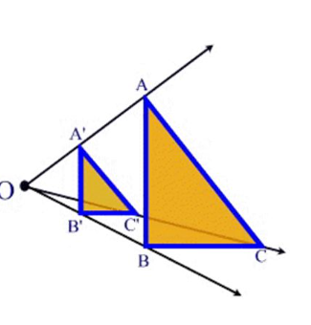
DILATION
A proportional enlargement or reduction of a figure.
Center of Dilation: the point a figure if enlarged/reduced through
Scale Factor: the size of the enlargement/reduction.
  Enlargement – greater than 1
  Reduction – less than 1
A figure and its dilated image are always similar.

Slide 45
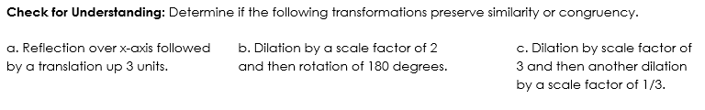
Check for understanding
Congruency
Similarity
Congruency

Slide 46
I-Do
Pre-Image | Process | Image
A (-2, -1) |  | A’ ( , )
B (2, -1) |  | B’ ( , )
C (-2, 1) |  | C’ ( , )
D (2, 1) |  | D’ ( , )
Used a scale factor of 2. Complete the table below and graph both the original (pre-image) and new (image) rectangle.
How did the following change?
A. Angle Measures:
THEY DON’T CHANGE
B. Length of Sides:
THEY ARE EACH LARGER BY 2 UNITS
2(-2,-1)
2(2,-1)
2(-2,1)
2(2,1)
-4 -2
4 -2
-4 2
4 2

Slide 47
You-Do
Pre-Image | Process | Image
A (-4, 4) |  | A’ ( , )
B (-4,-4) |  | B’ ( , )
C (4,4) |  | C’ ( , )
D (4,-4) |  | D’ ( , )
Used a scale factor of 1/2. Complete the table below and graph both the original (pre-image) and new (image) rectangle.
How did the following change?
A. Angle Measures:
THEY DON’T CHANGE
B. Length of Sides:
THEY ARE EACH SHORTER BY 2 UNITS
.5(-4,4)
.5(-4,-4)
.5(4,4)
.5(4,-4)
-2 2
-2 -2
2 2
2 -2

Slide 48

Finding Scale Factors
To find the scale factor of your new figure (image), you want to compare the ratio of the sides from the new figure to the original figure (pre-image).
Pre-image: ABC; Image: A’B’C’
$$Scale Factor: \frac{A′}{A}=\frac{B′}{B}=\frac{C′}{C}$$
Order matters when you are trying to find SCALE FACTOR!

Slide 49
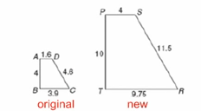

Example 3:
What is the scale factor of the dilation?
$$\frac{4}{1.6}=\frac{10}{4}=\frac{9.75}{3.9}=\frac{11.5}{4.6}$$
Scale factor: 2.5

Slide 50
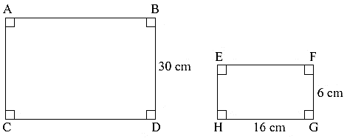
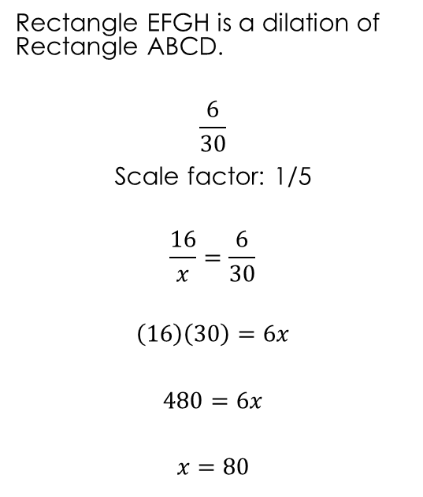
Example 4:
Rectangle EFGH is a dilation of Rectangle ABCD.
$$\frac{6}{30}$$
Scale factor: 1/5
$$\frac{16}{x}=\frac{6}{30}$$
$$\left(16\right)\left(30\right)=6x$$
$$480=6x$$
$$x=80$$

Slide 51
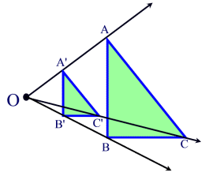
Center of Dilation
A fixed point in the plane about which all points in a figure are enlarged/reduced.
How to find:
Connect each corresponding vertex from the pre-image to the image.
The lines all meet at the center of dilation.

Slide 52
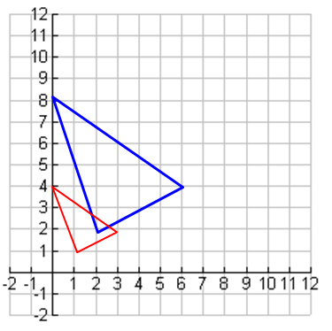
Finding Scale Factor
How to find the scale factor:
Find the center of dilation.
Compare the lengths/distances between the corresponding points to the center of dilation from new to old figure.

Slide 53
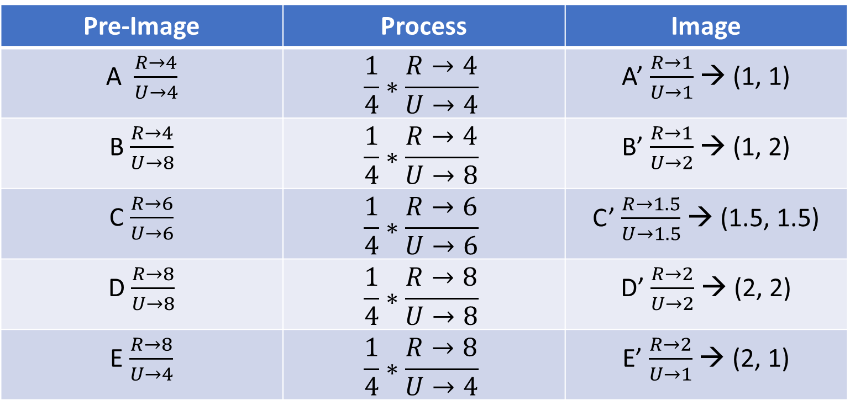
Performing Dilations
How to perform dilations:
Find location from center of dilation. (R, L, U, D)
Multiply by the scale factor.
Find new locations. Move from center of dilation.
  Example 6A: dilation by c = ¼, center (0,0)
Pre-Image | Process | Image
A $\frac{R→4}{U→4}$ | $$\frac{1}{4}∗\frac{R→4}{U→4}$$ | A’ $\frac{R→1}{U→1}$→ (1, 1)
B $\frac{R→4}{U→8}$ | $$\frac{1}{4}∗\frac{R→4}{U→8}$$ | B’ $\frac{R→1}{U→2}$ → (1, 2)
C $\frac{R→6}{U→6}$ | $$\frac{1}{4}∗\frac{R→6}{U→6}$$ | C’ $\frac{R→1.5}{U→1.5}$ → (1.5, 1.5)
D $\frac{R→8}{U→8}$ | $$\frac{1}{4}∗\frac{R→8}{U→8}$$ | D’ $\frac{R→2}{U→2}$ → (2, 2)
E $\frac{R→8}{U→4}$ | $$\frac{1}{4}∗\frac{R→8}{U→4}$$ | E’ $\frac{R→2}{U→1}$ → (2, 1)

Slide 54
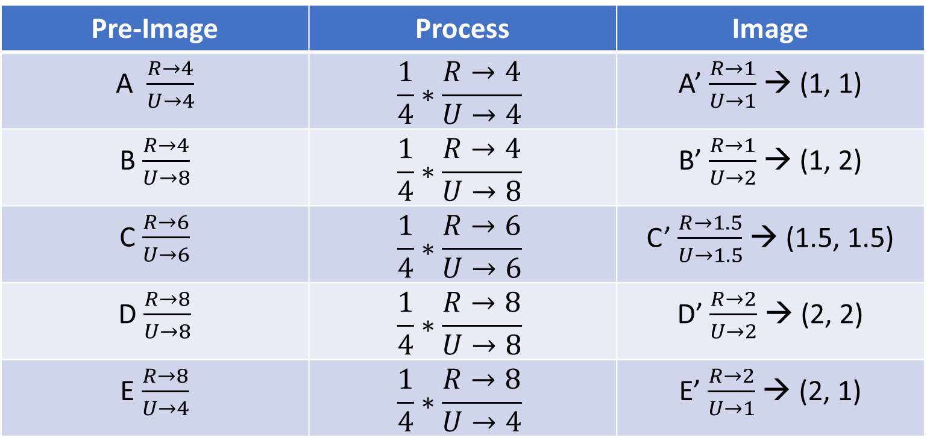
Performing Dilations
  Example 6B: dilation by c = 2, center (0,0)
Pre-Image | Process | Image
A $\frac{R→4}{U→4}$ | $$\frac{1}{4}∗\frac{R→4}{U→4}$$ | A’ $\frac{R→1}{U→1}$→ (1, 1)
B $\frac{R→4}{U→8}$ | $$\frac{1}{4}∗\frac{R→4}{U→8}$$ | B’ $\frac{R→1}{U→2}$ → (1, 2)
C $\frac{R→6}{U→6}$ | $$\frac{1}{4}∗\frac{R→6}{U→6}$$ | C’ $\frac{R→1.5}{U→1.5}$ → (1.5, 1.5)
D $\frac{R→8}{U→8}$ | $$\frac{1}{4}∗\frac{R→8}{U→8}$$ | D’ $\frac{R→2}{U→2}$ → (2, 2)
E $\frac{R→8}{U→4}$ | $$\frac{1}{4}∗\frac{R→8}{U→4}$$ | E’ $\frac{R→2}{U→1}$ → (2, 1)

