Slide 1
Day 5 – Introduction to Proofs
Unit 2: Congruence, Similarity, & Proofs

Slide 2
Introduction to Proofs
PROOF: Logical argument that uses a sequence of statements to prove a conjecture.
When writing an algebraic proof, you create a chain of logical steps that move from the hypothesis to the conclusion of the conjecture.
THEOREM: A proven conjecture.
When writing a proof, it is important to justify each logical step with a reason.
REASONS you can use: 1) Given Information, 2) Definitions, 3) Previously Proven Theorems or 4) Mathematical Properties.

Slide 3
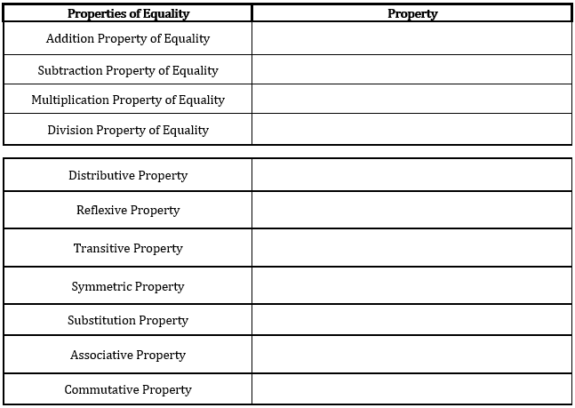
Introduction to Proofs
If a = b, then a + c = b + c
If a = b, then a – c = b – c
If a = b, then a · c = b · c
If a = b, and c ≠ 0, then $\frac{a}{c}=\frac{b}{c}$
a (b + c) = ab + ac
a = a
If a = b and b = c, then a = c
If a = b, then b = a
If a = b, the b can replace a in any expression
If a + (b + c) = (a + b) + c
If a + b = b + a

Slide 4
Introduction to Proofs
I-Do
Name the property or equality that justifies each statement
Substitution Property
Addition Property of Equality
Reflexive Property
Substitution

Slide 5

Introduction to Proofs
I-Do
Use the property to complete each statement
$$∠TRS$$
$$2+BC$$

Slide 6
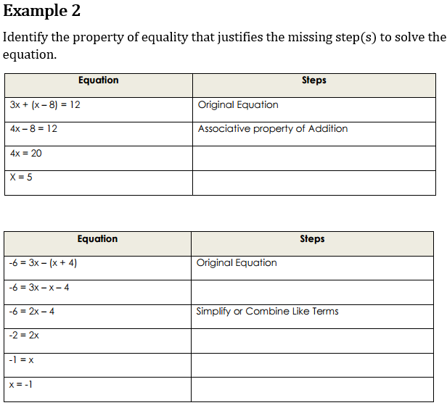
Introduction to Proofs
We-Do
Identify the Property of equality that justifies the missing step(s) to solve the equation
Addition Property
Division Property
Distributive Property
Addition Property
Division Property
Symmetric Property

Slide 7
Introduction to Proofs
We-Do
PR = 46 Given
PR = PQ + QR Segment Addition Postulate
46 = 2x + 5 + 6x – 15 Substitution
46 = 8x – 10 Combining Like Terms
56 = 8x Addition Property
7 = x Division Property
X = 7 Symmetry Property

Slide 8
Introduction to Proofs
We-Do
$\overline{AB}≅\overline{BC},\overline{CD}≅\overline{BC}$ Given
$\overline{AB}≅\overline{CD}$ Transitive Property
$\overline{AB}=\overline{CD}$ Definition of Congruent
$2x+1=4x−11$ Substitution
$12=2x$ Addition/Subtraction Property
$$\overline{AB}=13$$
$6=x$ Division Prop.
$x=6$ Symmetric Prop.
$$\overline{CD}=13$$

Slide 9
Introduction to Proofs
We-Do
2x +10 = 3x-15 Given
$25=x$ Subtraction/Addition
$x=25$ Symmetric Prop.
$m∠BDE=3\left(25\right)−15=60$ Substitution
$m∠DBC+m∠BDE=180$ Consecutive Int. Ang. Theorem
$m∠DBC+60=180$ Substitution
$m∠DBC=120$ Subtraction

Slide 10
Day 6 – Prove Theorems: Lines & Angles
Unit 2: Congruence, Similarity, & Proofs

Slide 11
WARM-UP
$\overline{ST}≅\overline{SR}$,$\overline{QR}≅\overline{SR}$ GIVEN
$\overline{ST}≅\overline{QR}$ TRANSITIVE PROP.
$\overline{ST}=\overline{QR}$ Def. of Congruent
$x+4=5(3x−2)$ SUBSTITUTION PROP.
$x+4=15x−10$ DISTRIBUTIVE PROP.
$x+14=15x$ ADDITION PROP.
$14=14x$ SUBTRACTION PROP.
$1=x$ DIVISION PROP.
$x=1$ SYMMETRIC PROP.

Slide 12
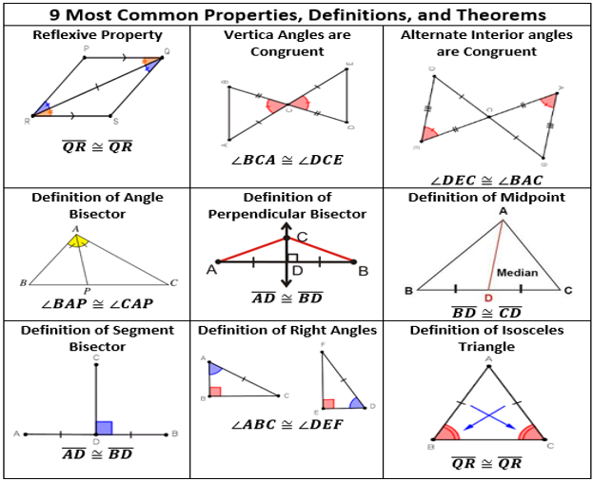
Geometric Proofs: Lines & Angles

Slide 13
Geometric Proofs: Lines & Angles
I-Do
Prove the Linear Pair Theorem
Definition of Opposite Rays
Definition of Linear Pair
$$m∠1+m∠2=m∠ABC$$
$$m∠1+m∠2=180$$
Definition of Supplementary

Slide 14
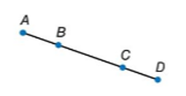
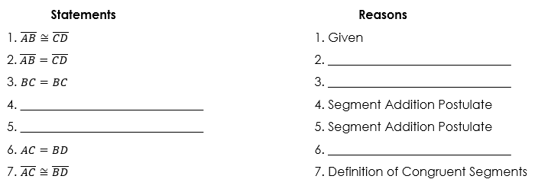
Geometric Proofs: Lines & Angles
I-Do
Prove Segment Addition Postulate
DEFINITION OF CONGRUENT
REFLEXIVE PROP.
$$\overline{AB}+\overline{BC}=\overline{AC}$$
$$\overline{BC}+\overline{CD}=\overline{BD}$$
SUBSTITUTION PROP.

Slide 15
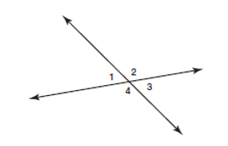
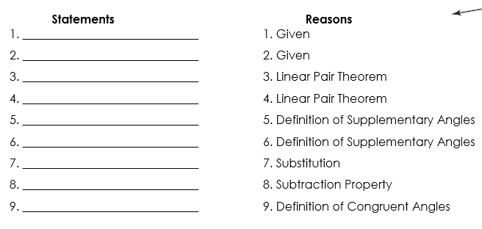
Geometric Proofs: Lines & Angles
We-Do
Angle 4 and 1 are a linear pair
Angle 1 and 2 are a linear pair
$∠4 and ∠1$ are supplementary
$∠1 and ∠2$ are supplementary
$$m∠1+m∠4=180$$
$$m∠1+m∠2=180$$
$$m∠1+m∠4=m∠1+m∠2$$
$$m∠4=m∠2$$
$$∠4≅∠2$$

Slide 16
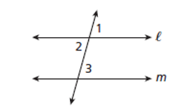
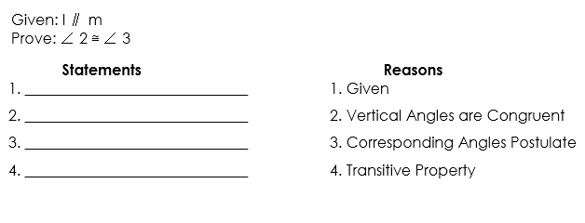
Geometric Proofs: Lines & Angles
We-Do
Prove: Alternate Interior Angles are Congruent
$$l∥m$$
$$∠1≅∠2$$
$$∠1≅∠3$$
$$∠2≅∠3$$

Slide 17
CHECK FOR UNDERSTANDING
GIVEN
Vertical Angles Theorem
Alt. Int. $∠$’s are Congruent
Transitive Property

Slide 18
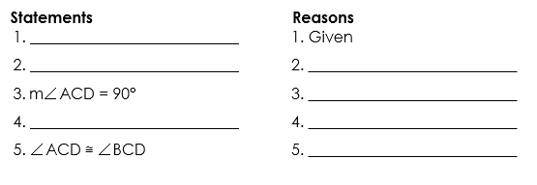
Geometric Proofs: Lines & Angles
We-Do
$$∠ACD and ∠BCD are right angles$$
$$m∠BCD=90$$
$$Def. of Right ∠^{′}s$$
$$Def. of Right ∠^{′}s$$
$$m∠BCD=m∠ACD$$
$$Substitution Prop.$$
$$Definition of Congruent ∠^{′}s$$

Slide 19
Day 7 – Prove Theorems: Triangles
Unit 2: Congruence, Similarity, & Proofs

Slide 20
Geometric Proofs: Triangles
TRIANGLE CONGRUENCE THEOREMS | DESCRIPTION
Side-Side-Side | All 3 sides of one triangle are congruent to 3 corresponding sides of another triangle.
Side-Angle-Side | Two sides and the included angle of one triangle are congruent to two corresponding sides and the included angle of another triangle.
Angle-Side-Angle | Two angles and the included side of one triangle are congruent to two corresponding angles and the included side of another triangle.
Angle-Angle-Side | Two angles and the non-included side of a triangle are congruent to two corresponding angles and the non-included side of another triangle.
Hypotenuse-Leg | The hypotenuse and a leg of a right triangle are congruent to the hypotenuse and the corresponding leg of another triangle.

Slide 21
Geometric Proofs: Triangles
I-Do
GIVEN
$$\overline{AC}≅\overline{AC}$$
REFLEXIVE PROPERTY
$$∆ABC≅∆CDA$$

Slide 22
CHECK FOR UNDERSTANDING
$$\overline{RF}≅\overline{BP}$$
GIVEN
$$\overline{BF}≅\overline{RP}$$
GIVEN
$$\overline{FP}≅\overline{FP}$$
REFLEXIVE PROPERTY
$$∆RFP≅∆BPF$$
S-S-S CONGRUENCE

Slide 23
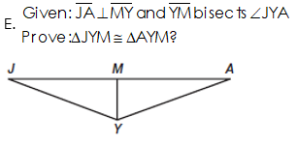
Geometric Proofs: Triangles
I-Do
STATEMENTS REASONS
$$\overline{JA}⊥\overline{MY}$$
$$GIVEN$$
$$\overline{MY} bisects ∠JYA$$
$$GIVEN$$
$$∠JMY≅∠AMY$$
$$Def. of Right Angles$$
$$\overline{MY}≅\overline{MY}$$
$$Reflexive Property$$
$$∠JMY≅∠AMY$$
$$A−S−A Congruence$$

Slide 24
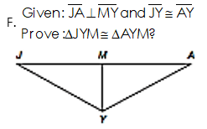
Geometric Proofs: Triangles
CHECK FOR UNDERSTANDING
STATEMENTS REASONS
$$\overline{JA}⊥\overline{MY}$$
$$GIVEN$$
$$\overline{\overline{JA}}≅\overline{AY}$$
$$GIVEN$$
$$\overline{MY}≅\overline{MY}$$
$$Reflexive Property$$
$$∠JMY≅∠AMY$$
$$ALL RIGHT ∠^{′}S ARE ≅$$
$$∆JYM≅∆AYM$$
$$H−L CONGRUENCE$$

Slide 25
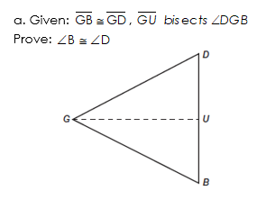
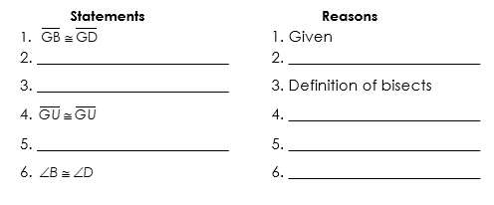
Geometric Proofs: Triangles
We-Do
PROVE THE ISOSCELES BASE ANGLES THEOREM
$$\overline{GU} bisects ∠DGB$$
$$GIVEN$$
$$∠DGU≅∠BGU$$
$$Reflexive Prop.$$
$$∆DGU≅∆BGU$$
$$S−A−S Congruence$$
$$C−P−C−T−C$$

